Slide 1
CSE471 Final Presentation
Group 7
Topic : StudentBook App for research and academic management

Slide 2
Contributions and Different Roles
Member1: Introduction and Requirements and Window Navigation
Member2: Use Case
Member3: ERD and Class Diagram [Member Absent]

Slide 3
Introduction Major Requirements
Provides users with personalized user accounts
Users can add each other as mentors/peers to communicate
Will provide a central layout section for users to post/upload their research based work.

Slide 4
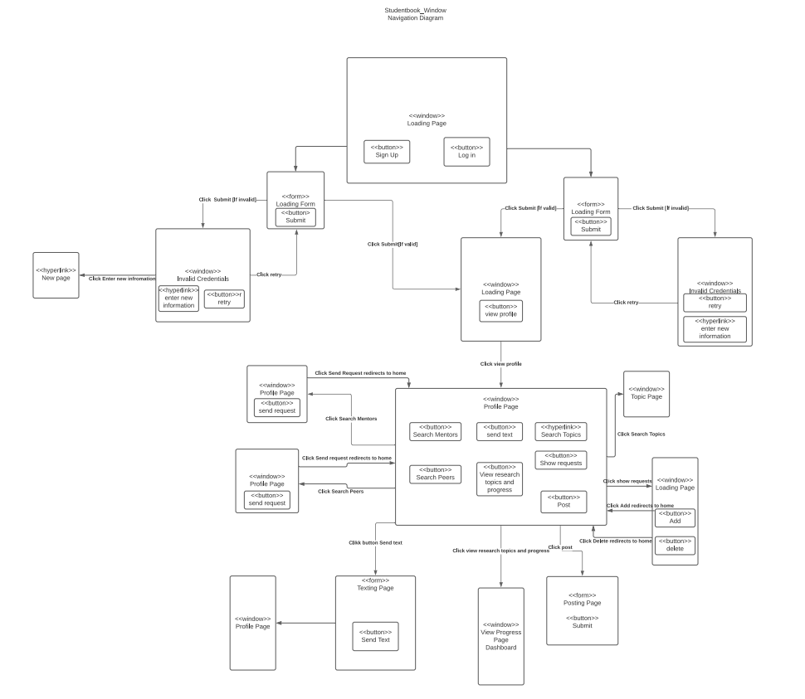

Slide 5
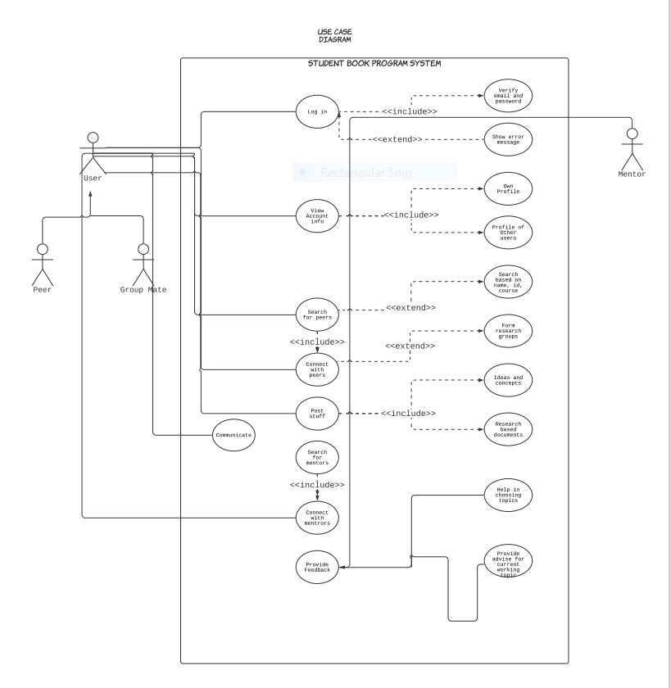
Use Case Diagram

Slide 6
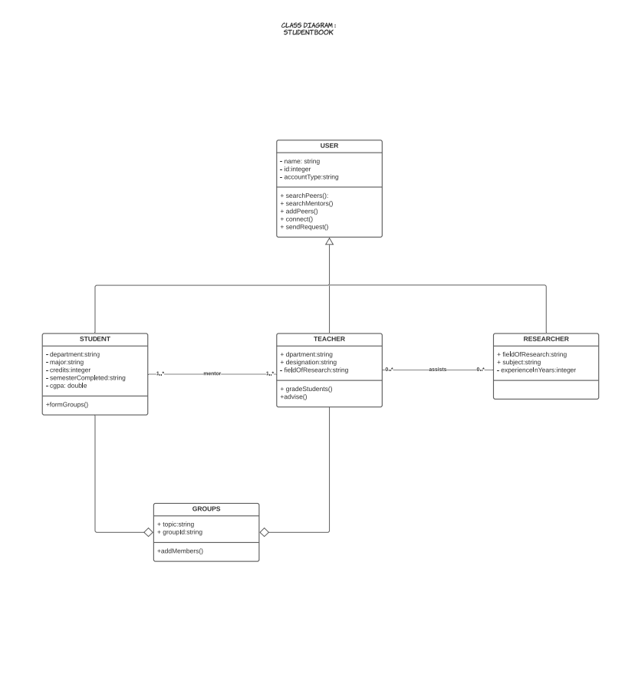

Slide 7
